Slide 1
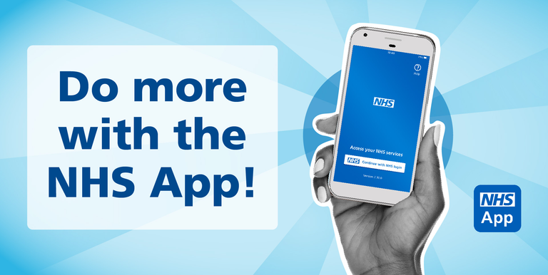
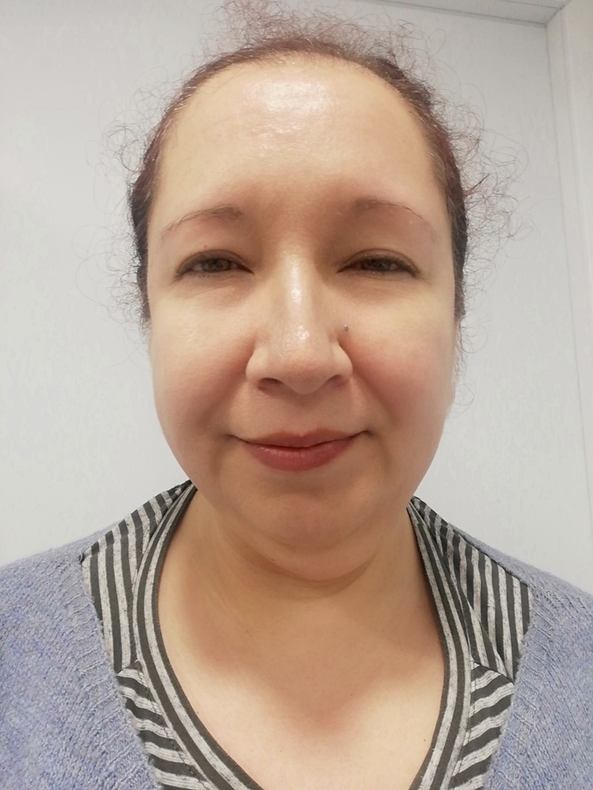




Digital
Ambassador
Service
“Hi, I’m Emma and I am
the Digital Ambassador for
Preston Park Surgery.
I will teach you how to manage your
health using your smartphone or PC at home.”

Slide 2
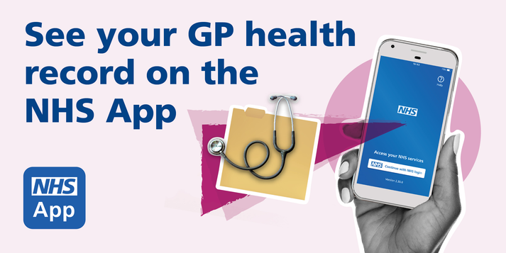
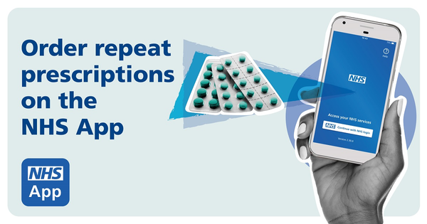
Manage your repeat prescriptions Make appointments
View your test results Get your covid pass for travel
A - Z of health information Register for organ donation
Sxicb-bh.prestonparkcommunitypcn@nhs.net
07808 646075
Digital Ambassador Drop - In
Tuesday mornings

